Slide 1
Student Outcomes for University and College

Slide 2
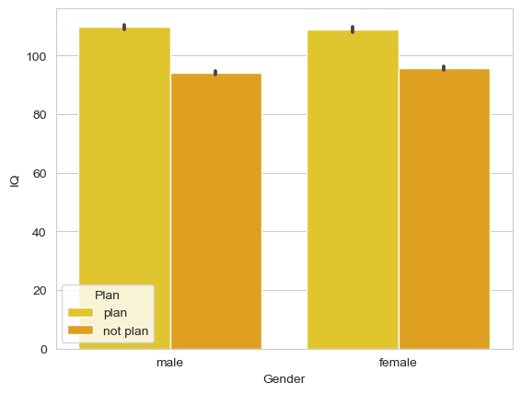
Decision to go to College by IQ and Gender
This bar plot depicts males and females IQs based off of whether they will plan to go to college or not. Evidently people with higher IQs are more likely to go to college than those with lower. It appears that males and females with high IQs do go to college while males and females with lower IQs are less likely.

Slide 3
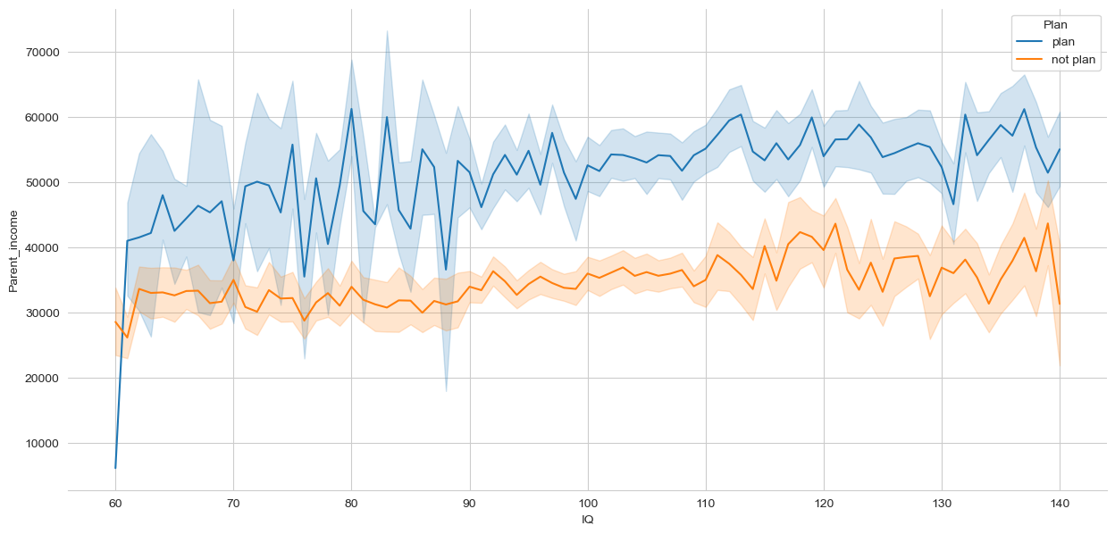
College Attendance as a factor of Parent income and IQ
Parental income is a larger factor in determining whether someone will plan to go to college rather than IQ. As you can see from the graph, some people with IQs as high as 140 do not attend college despite being smart enough to do so. While people with IQs as low as 60 still attend college.
Note: This is a fictional dataset. It does not reflect what actual salaries of college students’ parents really make.

Slide 4
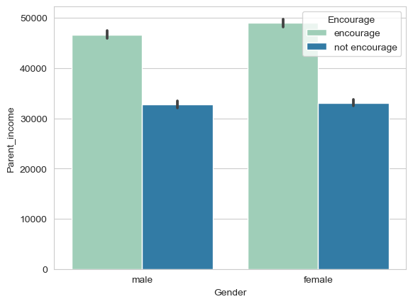
Encouragement to Attend College by Parent income and Gender
Students are more likely to be encouraged to go to college if their parents make a lot of money. Females are encouraged more than males to go to college.
Note:
This dataset has fictional salaries. It does not reflect what actual college student’s parents make.

Slide 5
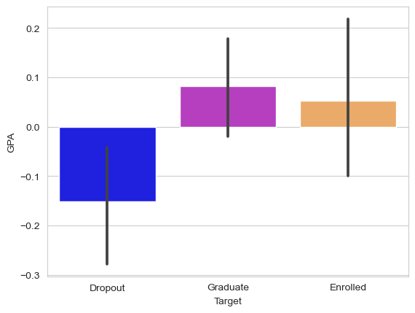
College Enrollment based off of GPA
The lower the GPA, the more likely a college student is to drop out. The higher the GPA the more likely the student is going to stay enrolled in the school or even graduate. Of course there are always outliers.
Note: The GPA scale represented on this chart is not indicative of the actual GPA on a 4 point scale. This is simply for visual purposes.

Slide 6
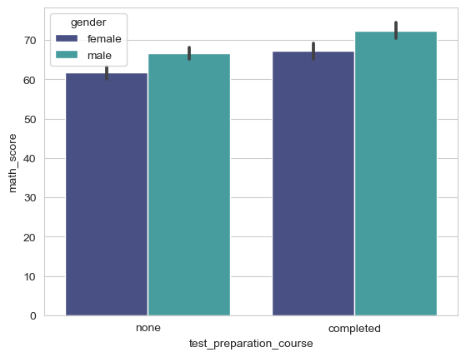
Efficacy of test preparation for math
Clearly people do better on math tests when they partake in test preparation. They do slightly worse when they don’t prepare. Males tend to do better than females in both scenarios.

Slide 7
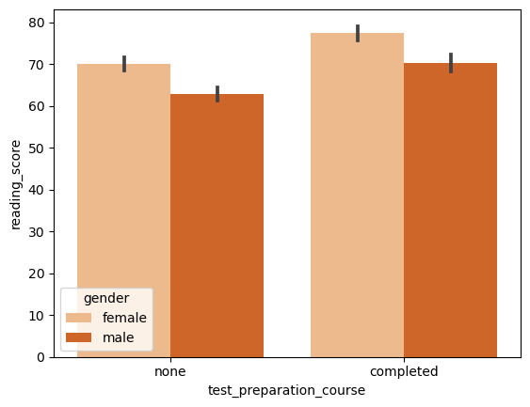
Efficacy of test preparation for reading tests
Preparing for reading tests helps students get higher reading scores for both male and female. Females tend to do better on reading tests than males with or without preparation.

Slide 8
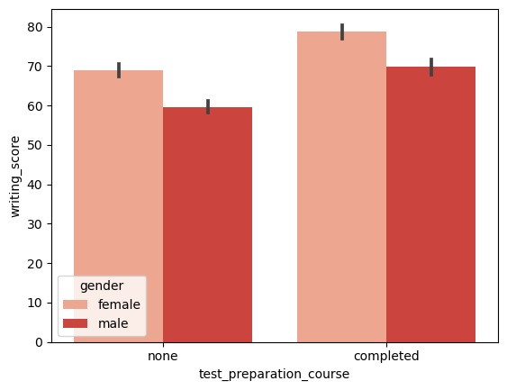
Efficacy of test preparation for writing tests
Like the other visualizations, preparing for the test in writing guarantees a higher score. Also like reading, females tend to do better in writing than males with or without the preparation.

Slide 9
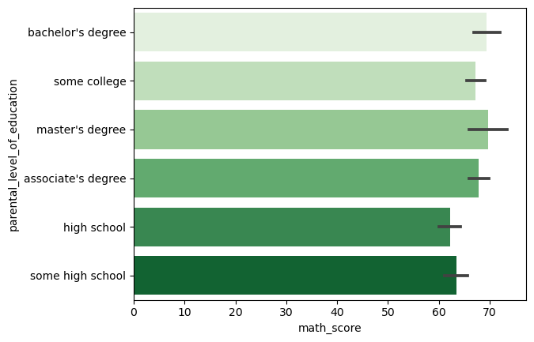
Parent’s level of education and math score
The higher the parent’s level of education is the better their kid will perform in math. And vice versa if a parent has less education, their child will most likely do worse in math than someone who’s parents have lots of education.

Slide 10
Conclusion
Many students benefit from going to college. Not everyone attends however. It is one path to getting a good job but not necessarily the only way to get a good job. The takeaway is not everyone that attends college is a genius but not everyone that doesn’t go is not intelligent.

